Slide 1

Student knowledge tracking and answer prediction system.
https://www.kaggle.com/c/riiid-test-answer-prediction
Team Members: Ankur Chaudhari, Ali Tootoonchi, Sudipto Sen

Slide 2
AIM:
1) To create algorithms for "Knowledge Tracing," the modeling of student knowledge over time.
2) To accurately predict how students will perform on future interactions.
PURPOSE:
1) Help tackle global challenges in education.
2) Using good ML model,it is possible that any student with an Internet connection can enjoy the benefits of a personalized learning experience.

Slide 3
Dataset Info
Train.csv contains:
row_id: (int64) ID code for the row.
timestamp: (int64) the time between this user interaction and the first event from that user.
user_id: (int32) ID code for the user.
content_id: (int16) ID code for the user interaction
content_type_id: (int8) 0 if the event was a question being posed to the user, 1 if the event was the user watching a lecture.
task_container_id: (int16) Id code for the batch of questions or lectures. For example, a user might see three questions in a row before seeing the explanations for any of them. Those three would all share a task_container_id. Monotonically increasing for each user.
user_answer: (int8) the user's answer to the question, if any. Read -1 as null, for lectures.
answered_correctly: (int8) if the user responded correctly. Read -1 as null, for lectures.
prior_question_elapsed_time: (float32) How long it took a user to answer their previous question bundle, ignoring any lectures in between. The value is shared across a single question bundle, and is null for a user's first question bundle or lecture. Note that the time is the total time a user took to solve all the questions in the previous bundle.
prior_question_had_explanation: (bool) Whether or not the user saw an explanation and the correct response(s) after answering the previous question bundle, ignoring any lectures in between. The value is shared across a single question bundle, and is null for a user's first question bundle or lecture. Typically the first several questions a user sees were part of an onboarding diagnostic test where they did not get any feedback.

Slide 4

Metadata for the questions posed to users.
question_id: foreign key for the train/test content_id column, when the content type is question (0).
bundle_id: code for which questions are served together.
correct_answer: the answer to the question. Can be compared with the train user_answer column to check if the user was right.
part: the relevant section of the TOEIC test.
tags: one or more detailed tag codes for the question. The meaning of the tags will not be provided, but these codes are sufficient for clustering the questions together.

Slide 5
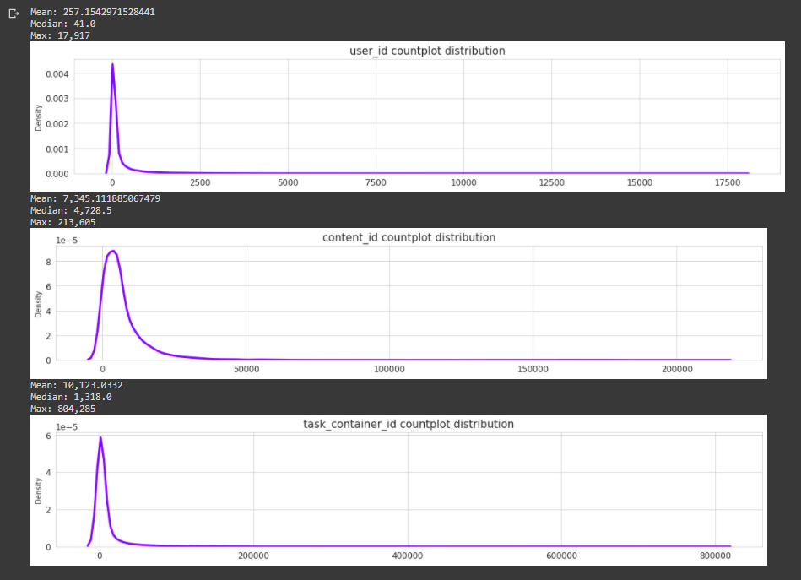
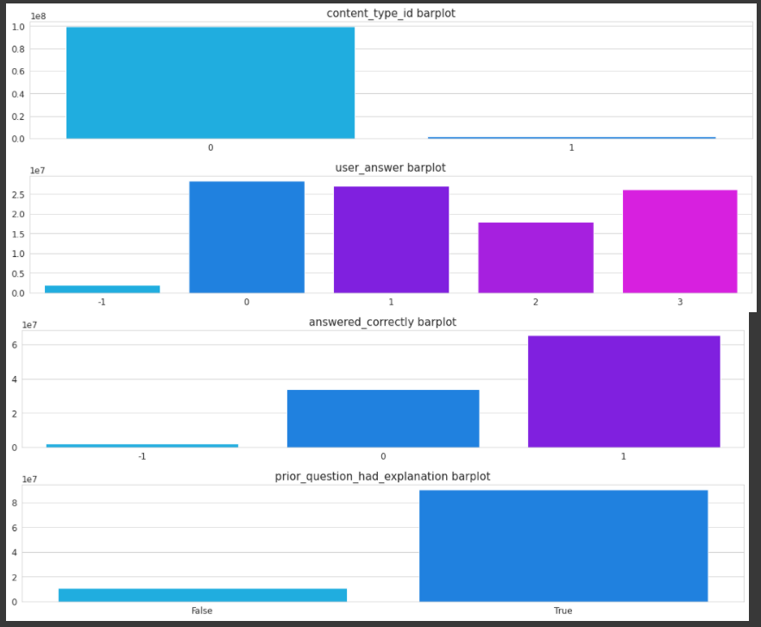
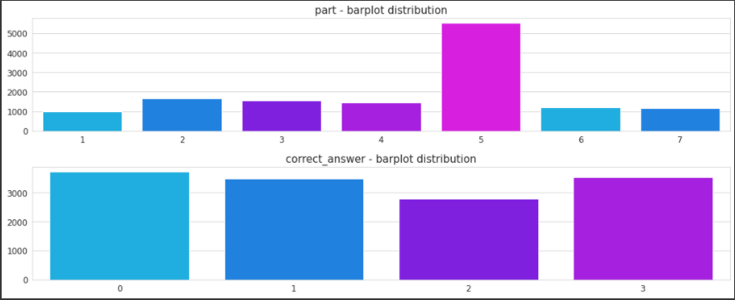
Data Analysis
Train.csv Categorical Data Analysis
questions.csv Categorical Data Analysis

Slide 6

Data Preprocessing
Removing Unwanted Attributes
Removing Unnecessary Data rows.
Grouping data with respect to user_id and timestamp attributes.
Replacing Null values with mean.
Split Train and Validation data.
Adding new features to dataset.
Merging training dataset with questions dataset.

Slide 7

Model 1: XGBoost
XGBoost stands for eXtreme Gradient Boosting.
It is an implementation of gradient boosting machines created by Tianqi Chen, now with contributions from many developers. It belongs to a broader collection of tools under the umbrella of the Distributed Machine Learning Community or DMLC who are also the creators of the popular mxnet deep learning library.

Slide 8

Model Features
The implementation of the model supports the features of the scikit-learn and R implementations, with new additions like regularization.
Gradient Boosting algorithm also called gradient boosting machine including the learning rate.
Stochastic Gradient Boosting with sub-sampling at the row, column and column per split levels.
Regularized Gradient Boosting with both L1 and L2 regularization.
XGBoost Model Performance:
XGBoost is much faster than other implementations of gradient boosting.
The XGBoost library implements the gradient boosting decision tree algorithm.
XGBoost dominates structured or tabular datasets on classification and regression predictive modeling problems.

Slide 9

The algorithm also differentiates itself in the following ways:
A wide range of applications: Can be used to solve regression, classification, ranking, and user-defined prediction problems.
Portability: Runs smoothly on Windows, Linux, and OS X.
Languages: Supports all major programming languages including C++, Python, R, Java, Scala, and Julia.
Cloud Integration: Supports AWS, Azure, and Yarn clusters and works well with Flink, Spark, and other ecosystems.

Slide 10

Gradient Boosting Fundamentals
Gradient boosting is a machine learning technique for regression and classification problems, which produces a prediction model in the form of an ensemble of different prediction models.
It builds the model in a stage-wise fashion like other boosting methods do, and it generalizes them by allowing optimization of an arbitrary differentiable loss function.

Slide 11
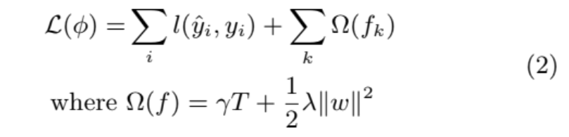
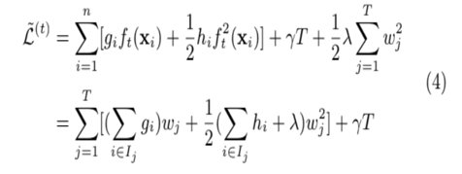
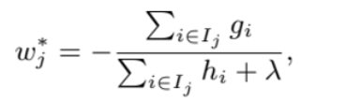
Mathemetics of the Model:
S
Just like Gradient Boost, XGBoost is the extreme version of it. When we use XGBoost, no matter we use it for classification or regression, it starts with an initial prediction and we use loss function to evaluate if the prediction works well or not.
Let’s say we have a datasets contains n example which means n row, we use i to represent each example in it. XGBoost uses loss function to build trees by minimizing the followin
In this equation, the first part represents for loss function which calculates the pseudo residuals of predicted value yi hat and true value yi in each leaf, the second part contains two parts just showed as above. The last part in omega formula contains regularization term lambda which intended to reduce the prediction’s insensitivity to individual observations and w represents the leaf weights which we could also consider it as the output value for the leaf. Also, T represents the number of terminal nodes or leaves in a tree and gamma represents the user-definable penalty which meant to encourage pruning.

Slide 12

XGBoost in Action:
At first, we put all residuals into one leaf and calculate the similarity score by simply setting lambda =0 . Then we consider whether we could do a better job clustering similar residuals if we split them into 2 groups. Then we calculate the similarity for each groups (leaf and right). Then we quantify how much better the leaves cluster similar residuals than the root by calculating the gain.
Gain = Left similarity + Right similarity- Root similarity
After this, we could compare the gain with this and gain with other thresholds to find the biggest one for better split.
For the leaves could be split, we continue the splitting and calculate the similarity score and gain just as before. Then we will talk about tree pruning based on its gain value. We start by picking a number as threshold, which is gamma. Then we calculate the difference between the gain associated with the lowest branch in the tree and the value for gamma (Gain-gamma). If the difference between the gain and gamma is negative, we remove the branch. If it is positive we will keep the branch so we finish the pruning. Note, we will never remove the root if we do not remove the first branch. However, if we prune the root, it shows us the initial prediction is all we left which is an extreme pruning.
Then we go back to the original residuals and build a tree just like before, the only difference is we change the lambda value to 1. We calculate the similarity score and gain in just the same way and we found that when lambda is larger than 0, the similarity and gain will be smaller and it is easier to prune leaves. The lambda prevented over-fitting the training data.
After we build the tree, we start to determine the output value of the tree. Then we can make prediction based on the tree. The new prediction is:
Initial predicted value + learning rate (eta) x output value
We could simply compare the new residuals and found that whether we have taken a small step in the right direction. We keep building other trees based on new residuals and make new prediction gives smaller residuals until residuals are supper small or reached maximum number.

Slide 13
For the data discussed earlier, XGBClassifier was used to make predictions of answers correctly provided by the students. On implementing the model with default parameters, we get the following output:
XGBoost: ROC AUC = 74.982
CPU times: user 35min 41s, sys: 3.78 s, total: 35min 45s
Wall time: 35min 45s
After tuning the parameters, the performance of xgboost method is greatly enhanced. The following is the output:
ROC for XGBoost model
76.18585945322294
CPU times: user 2.83 s, sys: 507 ms, total: 3.34 s
Wall time: 3.34 s
Thus, the model training time is reduced from 35min 45s to 3.34s !

Slide 14
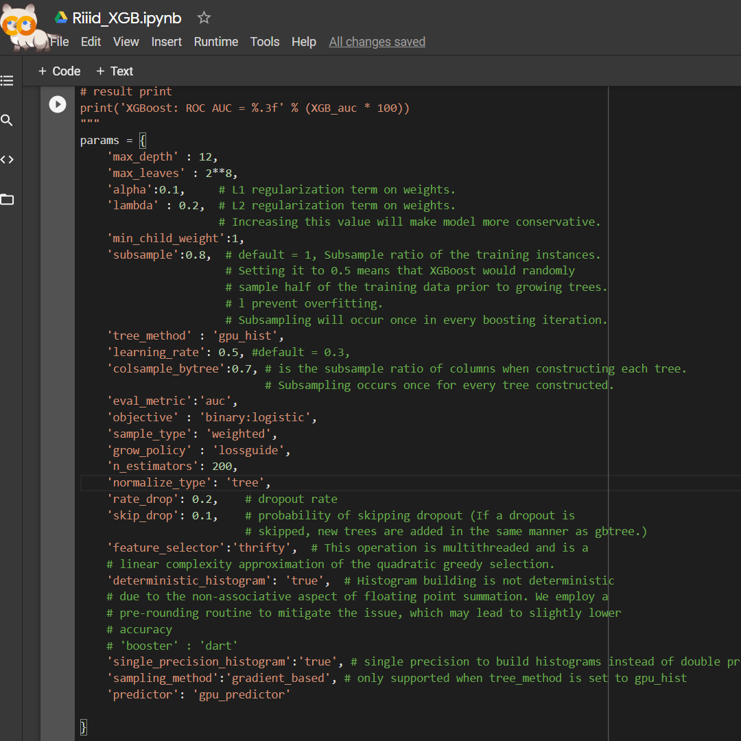
Parameters tuned:
tree_method, learning_rate, alpha, lambda, rate_drop, skip_drop, sample_type, subsample, single_precision_histogram, n_estimators, max_depth, max_leaves, feature_selector

Slide 15
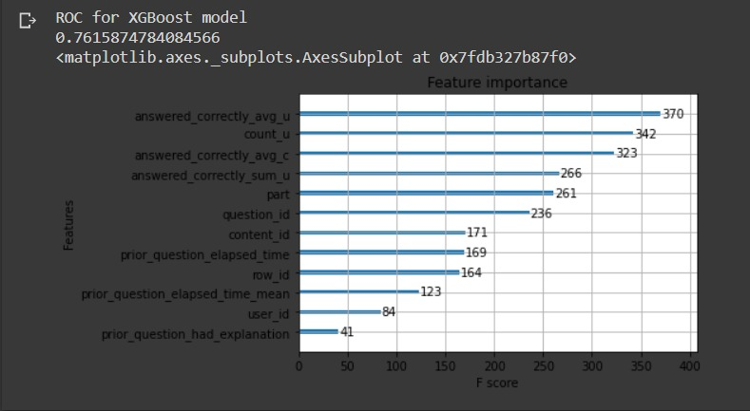

Slide 16
Model 2: LightGBM
LightGBM is a gradient boosting framework that uses tree based learning algorithms. It is designed to be distributed and efficient with the following advantages:
Faster training speed and higher efficiency.
Lower memory usage.
Better accuracy.
Support of parallel and GPU learning.
Capable of handling large-scale data.

Slide 17
LightGBM Features
The LightGBM framework supports different algorithms including GBT, GBDT, GBRT, GBM, MART and RF.
LightGBM has many of XGBoost's advantages, including sparse optimization, parallel training, multiple loss functions, regularization, bagging, and early stopping.
A major difference between the two lies in the construction of trees. LightGBM does not grow a tree level-wise — row by row — as most other implementations do. Instead it grows trees leaf-wise. It chooses the leaf it believes will yield the largest decrease in loss.
Besides, LightGBM does not use the widely-used sorted-based decision tree learning algorithm, which searches the best split point on sorted feature values, as XGBoost or other implementations do.
Instead, LightGBM implements a highly optimized histogram-based decision tree learning algorithm, which yields great advantages on both efficiency and memory consumption

Slide 18
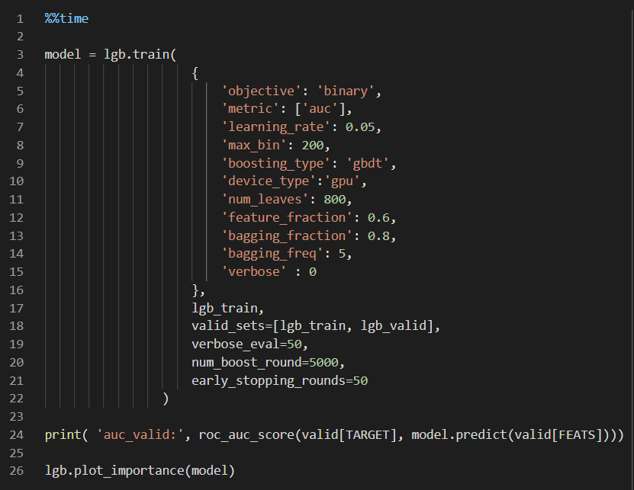
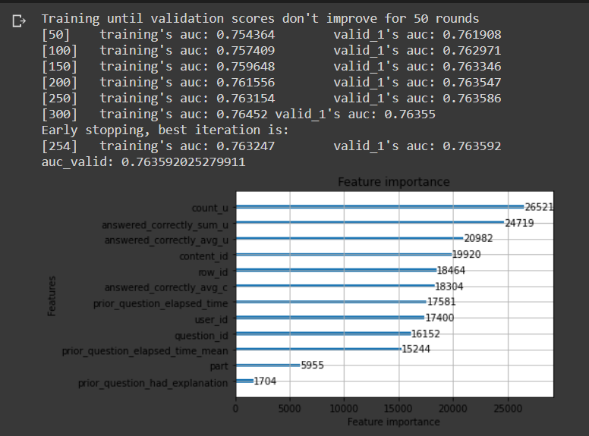
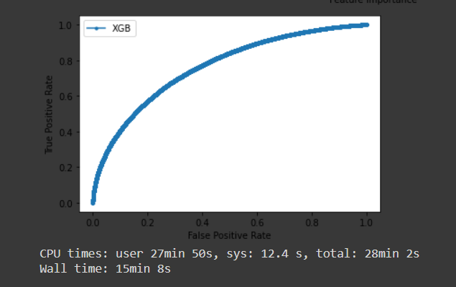
LightGBM Output

Slide 19

Model 3 : CatBoost
Catboost is an open-source library for gradient boosting on decision trees.
It is developed by Yandex researchers and engineers, and is used for search, recommendation systems, personal assistant, self-driving cars, weather prediction and many other tasks at Yandex and in other companies, including CERN, Cloudflare, Careem taxi. It is in open-source and can be used by anyone.

Slide 20

Model features
Performs well with default parameters
Supports categorical features
built-in model analysis tools
presents high speed in training on CPU and GPU
Reduce overfitting when constructing your models with a novel gradient-boosting scheme.

Slide 21
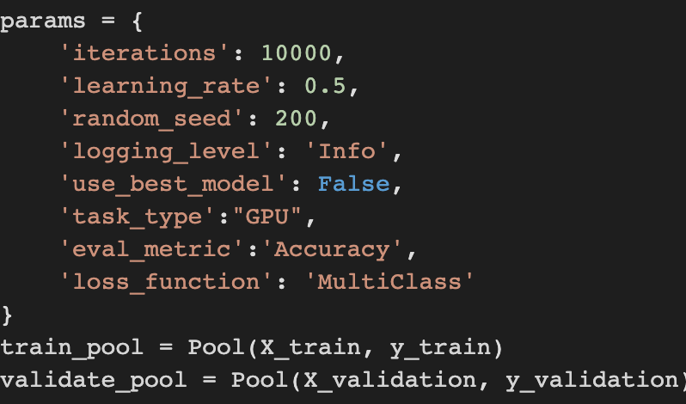
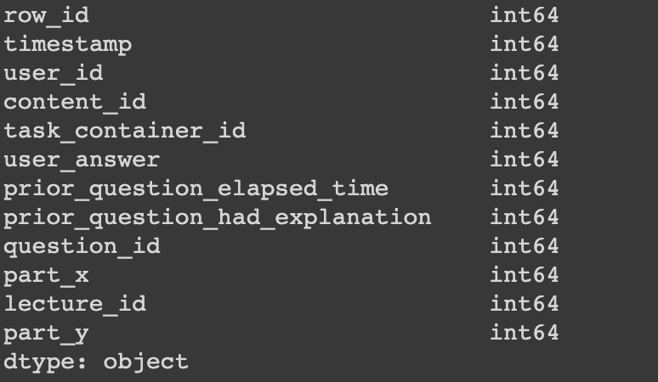
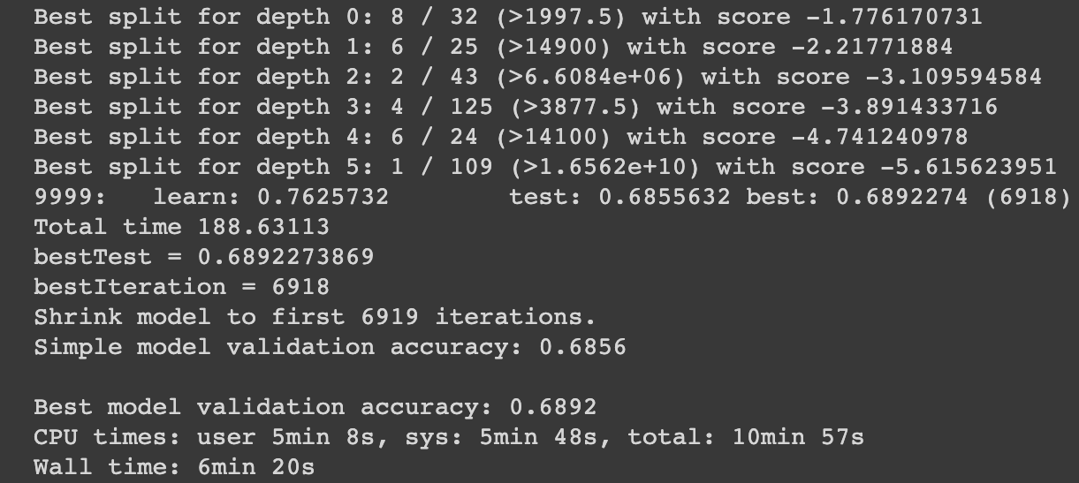
Outputs

Slide 22

Thank You

